Slide 1
BLOCKCHAIN TECHNOLOGIES
Dr Thippeswamy MN
Prof and Head

Slide 2
INTRODUCTION
The concept and applications of Blockchain have now spread from cryptocurrencies to various other domains, including business process management, smart contracts, IoT and so on.
This includes the fundamental design and architectural primitives of Blockchain, the system and the security aspects, along with various application domains.

Slide 3
PREREQUISITES:
Student should have prior basic knowledge on Python, Data Structures and OOP Concepts , Cryptography
Students should be able to develop a webpage by the use of Java Script.

Slide 4
COURSE OBJECTIVES:
Understand how blockchain systems (mainly Bitcoin and Ethereum) work
Understand emerging abstract concepts of Block chain Technology.
Design, build, and deploy smart contracts and distributed applications,
Attain awareness of security aspects of bit coin and Block chain technology.

Slide 5
COURSE CONTENTS:
INTRODUCTION TO BLOCKCHAIN
Classical Blockchain data structure; Foundational technologies: Hashing, Cryptography, Mining, Key Exchange, Smart contracts, Bitcoin Transactions, public vs permissioned.
Blockchain data structures: Merkle Tree, Patricia Tree
Hashing Applications, Key distribution, Diffie Hellman problems, PKE and RSA algorithms.

Slide 6
SOLIDITY AND DAPPS
Ethereum Clients, Go- Ethereum Clients(geth),Python Ethereum Client (pyethapp),Ethereum Languages,Solidity,TestRPC,Mist Ethereum Wallet,MetaMask,Web3 JavaScript API, Ethereum Accounts.
Smart Contract, Structure of a Contract, Setting up and Interacting with the Contract using Geth client, Compiling and Developing Contract,Transactions and Calls, Interacting with the Contract, Gas ,Logs, Events, Setting up and Interacting with a Contract using Mist Wallet, Compiling and Developing Contract, Interacting with the Contract, Smart Contract Examples.

Slide 7
CONSENSUS ALGORITHMS AND CLASSICAL RESULTS
Blockchain Scalability, Double-Spending Problem, Why consensus is harder in Blockchain?Classical Results, Byzantine Fault Tolerance(PBFT in detail), Proof-of-Work Vs Proof-of-Stake, Consistency, Availability & Partition Tolerance (CAP), Turing Completeness, Greedy Heaviest-Observed Sub-Tree (GHOST), Sybil Attack, Mining Pools and Centralization, Zero knowledge Proof(ZeroCoin).

Slide 8
NEXT GENERATION OF BLOCKCHAINS
HyperLedger: Fabric/Sawtooth - Introduction to generic blockchains and smart contracts.
Building applications with HyperLedger Fabric/Sawtooth. Comparison between HyperLedger and Ethereum.
IoTA: Introduction to The Tangle. Concepts of Merkle trees to be applied. Path traversal and development using Javascript Libraries.
BITCOIN AND BLOCKCHAIN SECURITY
Securing Bitcoin and blockchain, Security practices for your wallet, Types of wallets, Hardware wallets, Workings of a hardware wallet, Types of physical Bitcoins, The survival of cryptocurrencies.

Slide 9
COURSE PROJECT
Students will have to design and build a first block chain, create wallets and send signed transactions using block chain using any language of their choice. GROUPS: Students need to form a group of 4 students. All members will collectively submit a single copy of all works.
TEXT BOOKS:
Imran Bashir , Mastering Blockchain, second edition, PACKT
Arshdeep Bahga, Vijay Madisetti, “Blockchain Applications- A Hands-on Approach”, VPT; 1 Edition, 2017
Kirankalyan Kulkarni,”Learn Bitcoin and Blockchain”,Packt Publishing, 2018.
Melanie Swan,“Blockchain: Blueprint for a New Economy, 1st Edition , O’Reilly Publications, 2015.

Slide 10
COURSE OUTCOMES (COS): AT THE END OF THE COURSE STUDENT WILL BE ABLE TO:
CO | Description
CO1: | Identify the importance of Cryptocurrency, block chain technology and Applications
CO2: | Demonstrate the usage of the Etherum based block chain platform
CO3: | Setting up and Interacting with the Smart Contracts
CO4: | Understand the advanced block chain, security concerns of Block chain Technology, Bitcoins
CO5: | Design, build, and deploy a distributed application.

Slide 11
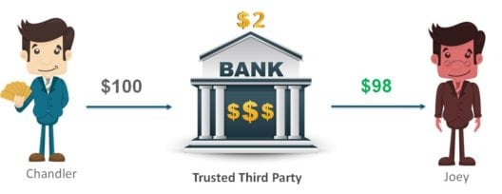
WHAT IS BLOCKCHAIN:
We will begin this Blockchain Concepts by understanding the problems of the current banking system.
Issues with Current Banking System:
Any existing system will have some issues. Let us look at some of the most commonly faced issues with the Banking system:
High Transaction Fees
Let’s look at an example to understand this issue better:

Slide 12
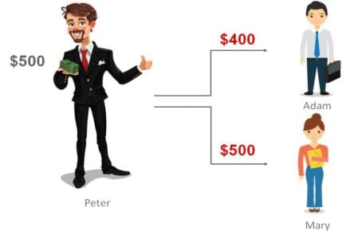
As per a report from SNL Financial and CNNMoney, JPMorgan Chase, Bank of America and Wells Fargo earned more than $6 billion from ATM and overdraft fees in 2015.
Double Spending
Double-spending is an error in digital cash scheme in which the same single digital token is spent twice or more. To help you understand this problem better, let me give you an example:
Here Peter has only $500 in his account. He initiates 2 transactions simultaneously to Adam for $400 and Mary for $500. Normally this transaction would not go through as he doesn’t have sufficient balance of $900 in his account. However, by duplicating or falsifying the digital token associated with every digital transaction, he can complete these transactions without the needed balance. This operation is known as Double Spending.

Slide 13
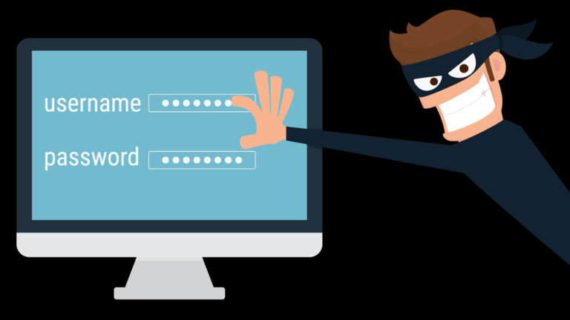
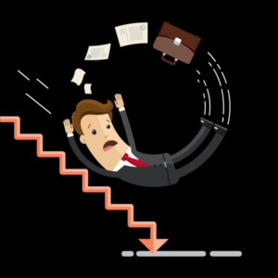
NET FRAUDS AND ACCOUNT HACKING
In India, the number of fraud cases related to credit/debit cards and Internet banking was 14,824 for the year 2016. The net amount involved in these frauds was Rs 77.79 crore, of which Rs 21 crore was from internet frauds and Rs 41.64 crore was from ATM/debit card-related frauds.
FY20 saw over 50,000 cases of fraud usage of debit, credit cards
'₹615.39cr lost to debit, credit card frauds' - mumbai news ...
Financial Crisis and Crashes
Imagine giving all your saving to someone you trust only to know that they have gone and lost it somewhere else. That’s what happened in the 2007-08 when Banks and Investment Organisations had borrowed heavily and lent it as subprime mortgages to people who could not even pay back these loans. This in turn lead to one of the greatest financial crisis ever seen and was estimated to have caused losses close to $11 Trillion ($11,000,000,000,000) worldwide. This was just one of the most popular examples, how often have we heard of Banks and Financial service companies crash due to internal frauds? The whole third-party system is something that is built on blind trust on the middle man.

Slide 14
HOW DOES BLOCKCHAIN SOLVE THESE ISSUES?
Below are some of the ways through which the Blockchain technology tackles the above mentioned issues:
Decentralized System
The Blockchain system follows a decentralized approach when compared to banks and financial organisations which are controlled and governed by Central or Federal Authorities. Here, everyone who is part of the system becomes equally responsible for the growth and downfall of the system. Rather than one single entity holding the power, everyone who is involved with the system holds some power.
Public Ledgers
The ledger which holds the details of all transactions which happen on the Blockchain, is open and completely accessible to everyone who is associated with the system. Once you join the Blockchain network, then you can download the complete list of transaction since its initiation. Even though the complete ledger is publicly accessible, the details of the people involved in the transactions remains completely anonymous.

Slide 15
VERIFICATION OF EVERY INDIVIDUAL TRANSACTION
Every single transaction is verified by cross-checking the ledger and the validation signal of the transaction is sent after a few minutes. Through the usage of several complex encryption and hashing algorithm, the issue of double spending is eliminated.
Low or No Transaction Fees
The transaction fees are usually not applicable but certain variants of Blockchain do implement certain minimal transactions fees. These transaction fees are however relatively quite less when compared to the fees implied by banks and other financial organisations. If a transaction needs to be completed on priority then an additional transaction fees can be added by the user so as to have the transaction verified on priority.

Slide 16

WHAT IS BLOCKCHAIN?
https://www.edureka.co/blog/blockchain-tutorial/
Blockchain is a distributed and public ledger which maintains records of all the transactions.
Is a truly Peer-to-peer Network and it does not require a trusted central authority or intermediaries to authenticate or to settle the transactions or to control the network infrastructure.

Slide 17
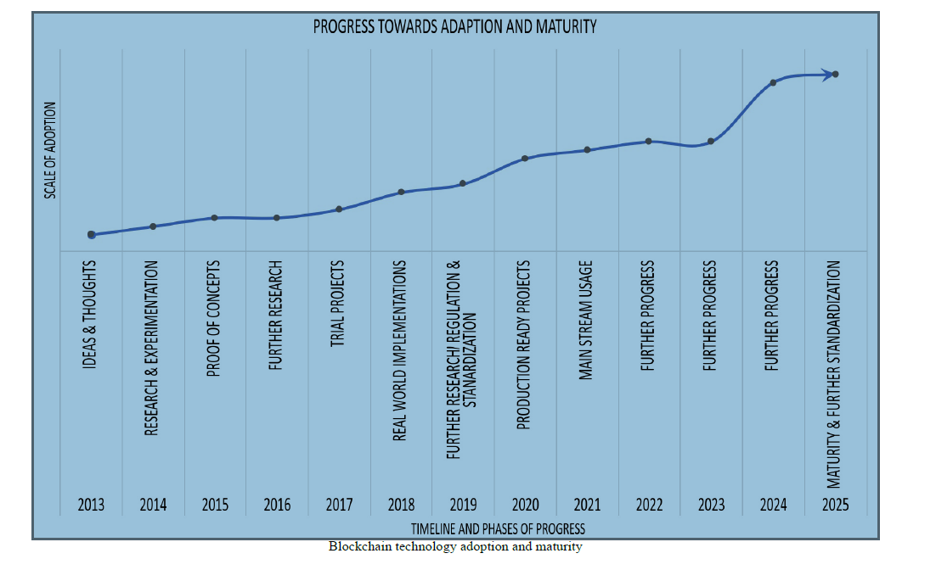
THE GROWTH OF BLOCKCHAIN TECHNOLOGY

Slide 18
DISTRIBUTED SYSTEMS
Distributed systems
Understanding distributed systems is essential to the understanding of blockchain technology, as blockchain is a distributed system at its core. It is a distributed ledger which can be centralized or decentralized.
A blockchain is originally intended to be and is usually used as a decentralized platform. It can be thought of as a system that has properties of both decentralized and distributed paradigms. It is a decentralized-distributed system.
Distributed systems are a computing paradigm whereby two or more nodes work with each other in a coordinated fashion to achieve a common outcome. It is modeled in such a way that end users see it as a single logical platform.
For example, Google's search engine is based on a large distributed system, but to a user, it looks like a single, coherent platform.
A node can be defined as an individual player in a distributed system. All nodes are capable of sending and receiving messages to and from each other. Nodes can be honest, faulty, or malicious, and they have memory and a processor. A node that exhibits irrational behavior is also known as a Byzantine node after the Byzantine Generals Problem.

Slide 19
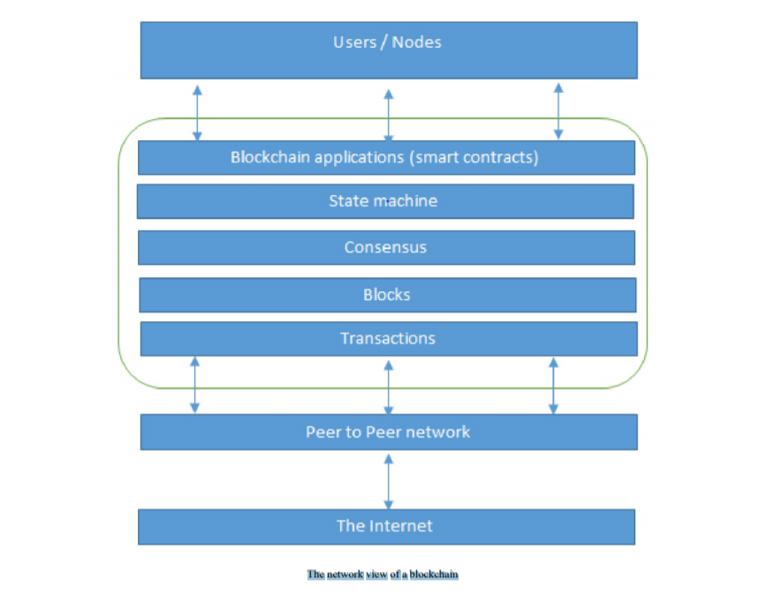
THE NETWORK VIEW OF A BLOCKCHAIN
The network view of a blockchain

Slide 20
At the bottom layer in the preceding diagram, there is the internet, which provides a basic communication layer for any network.
In this case, a peer-to-peer network runs on top of the internet, which hosts another layer of blockchain. That layer contains transactions, blocks, consensus mechanisms, state machines, and blockchain smart contracts.
All of these components are shown as a single logical entity in a box, representing blockchain above the peer-to-peer network. Finally, at the top, there are users or nodes that connect to the blockchain and perform various operations such as consensus, transaction verification, and processing.

Slide 21
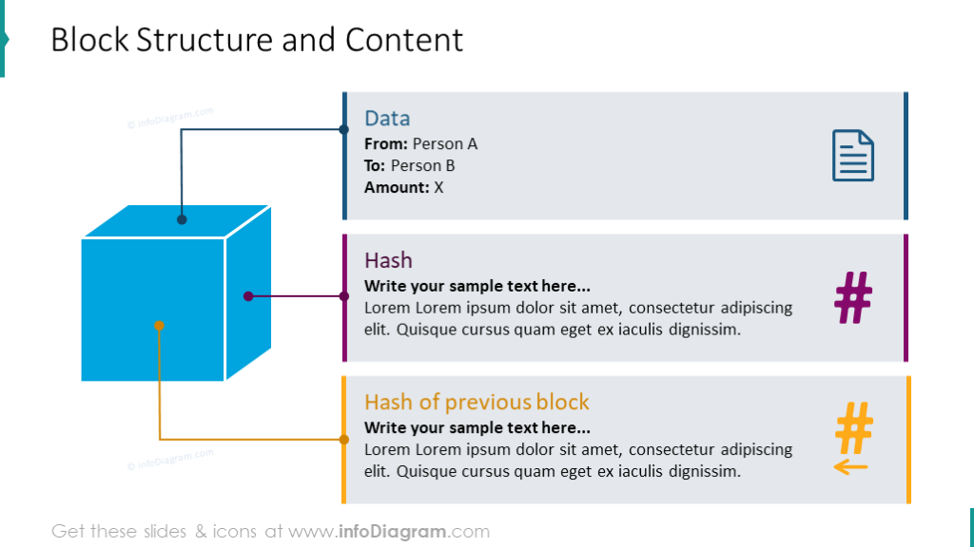
A block is merely a selection of transactions bundled together and organized logically.
A transaction is a record of an event, for example, the event of transferring cash from a sender's account to a beneficiary's account.
A block is made up of transactions, and its size varies depending on the type and design of the blockchain in use.

Slide 22
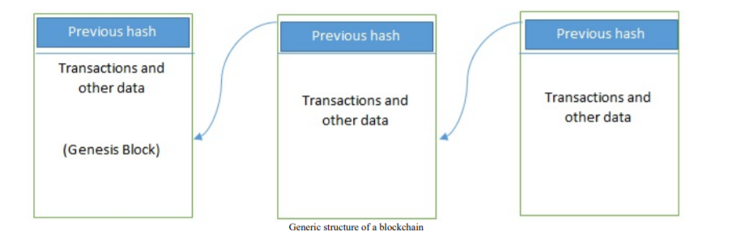
GENERIC ELEMENTS OF A BLOCKCHAIN

Slide 23
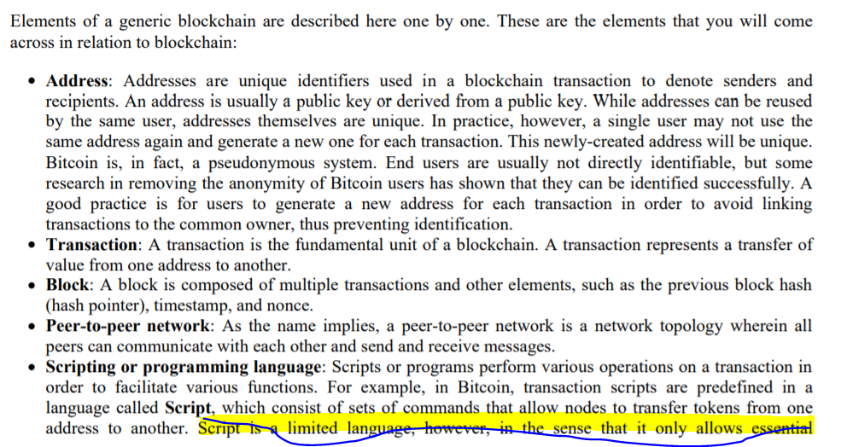

Slide 24
What is Blockchain?
Blockchain is a system comprised of..
Transactions
Immutable ledgers
Decentralized peers
Encryption processes
Consensus mechanisms
Optional Smart Contracts
Let’s explore these concepts

Slide 25
Transactions
As with enterprise transactions today, Blockchain is a historical archive of decisions and actions taken
Proof of history, provides provenance
Demo - https://anders.com/blockchain/blockchain.html
Notable transaction use cases
Land registration – Replacing requirements for research of Deeds (Sweden Land Registration)
Personal Identification – Replacement of Birth/Death certificates, Driver’s Licenses, Social Security Cards (Estonia)
Transportation – Bills of Lading, tracking, Certificates of Origin, International Forms (Maersk/IBM)
Banking – Document storage, increased back office efficiencies (UBS, Russia’s Sberbank)
Manufacturing – Cradle to grave documentation for any assembly or sub assembly
Food distribution – Providing location, lot, harvest date Supermarkets can pin point problematic food (Walmart)
Audits – Due to the decentralized and immutable nature of Blockchain, audits will fundamentally change.

Slide 26
Immutable
As with existing databases, Blockchain retains data via transactions
The difference is that once written to the chain, the blocks can not be changed, but it is extremely difficult to do so. Requiring rework on all subsequent blocks and consensus of each.
The transaction is, immutable, or indelible
In DBA terms, Blockchains are Write and Read only
Like a ledger written in ink, an error would be be resolved with another entry

Slide 27
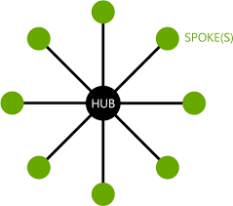
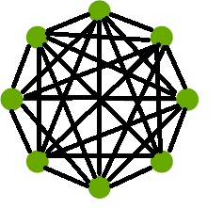
Decentralized Peers
Rather than the centralized “Hub and Spoke” type of network, Blockchain is a decentralized peer to peer network. Where each NODE has a copy of the ledger.
Legacy Network Blockchain Network
Centralized DB Distributed Ledgers

Slide 28
Encryption
Standard encryption practices
Some Blockchains allow for “BYOE” (Bring Your Own Encryption)
Only as good as the next hardware innovation
All blocks are encrypted
Some Blockchains are public, some are private
Public Blockchains are still encrypted, but are viewable to the public, e.g. https://www.blocktrail.com/BTC
Private Blockchains employ user rights for visibility, e.g.
Customer – Writes and views all data
Auditors – View all transactions
Supplier A – Writes and views Partner A data
Supplier B – Writes and views Partner B data

Slide 29
Consensus
Ensures that the next block in a blockchain is the one and only version of the truth
Keeps powerful adversaries from derailing the system and successfully forking the chain
Many Consensus mechanisms, each with pros and cons
Consensus Mechanism
Proof of Work
Proof of State
Proof of Elapsed Time
Proof of Activity
Proof of Burn
Proof of Capacity
Proof of Importance
And others….

Slide 30

Smart Contracts
A smart contract is a computer program or a transaction protocol which is intended to automatically execute, control or document legally relevant events and actions according to the terms of a contract or an agreement.
Blockchain | Smart Contracts? | Language
Bitcoin | No
Ethereum | Yes | Solidity
Hyperledger | Yes | Various | GoLang, C++, etc, depends
Others | Depends | Depends

Slide 31
Example:
The easiest way to explain what a smart contract does is through an example.
If you’ve ever bought a car at a dealership, you know there are several steps and it can be a frustrating process.
If can’t pay for the car outright, you’ll have to obtain financing.
This will require a credit check and you’ll have to fill out several forms with your personal information to verify your identity.
Along the way, you’ll have to interact with several different people, including the salesperson, finance broker and lender.
To compensate their work, various commissions and fees are added to the base price of the car.

Slide 32
What smart contracts on blockchain can do is streamline this complex process that involves several intermediaries because of a lack of trust among participants in the transaction.
With your identity stored on a blockchain, lenders can quickly make a decision about credit.
Then, a smart contract would be created between your bank, the dealer and the lender so that once the funds have been released to the dealer, the lender will hold the car’s title and repayment will be initiated based on the agreed terms.
The transfer of ownership would be automatic as the transaction gets recorded to a blockchain, is shared among the participants and can be checked at any time.

Slide 33
What are the benefits of smart contracts?
The benefits of smart contracts go hand-in-hand with blockchain.
Speed and accuracy: Smart contracts are digital and automated, so you won’t have to spend time processing paperwork or reconciling and correcting the errors that are often written into documents that have been filled manually. Computer code is also more exact than the legalese that traditional contracts are written in.
Trust: Smart contracts automatically execute transactions following predetermined rules, and the encrypted records of those transactions are shared across participants. Thus, nobody has to question whether information has been altered for personal benefit.
Security: Blockchain transaction records are encrypted, and that makes them very hard to hack. Because each individual record is connected to previous and subsequent records on a distributed ledger, the whole chain would need to be altered to change a single record.
Savings: Smart contracts remove the need for intermediaries because participants can trust the visible data and the technology to properly execute the transaction. There is no need for an extra person to validate and verify the terms of an agreement because it is built into the code.
https://www.ibm.com/blogs/blockchain/2018/07/what-are-smart-contracts-on-blockchain/

Slide 34
Miners
New blocks are created and added to the blockchain in a process called mining
The nodes in the blockchain network are called miners
New transactions are broadcasted to all the nodes on the networks
Each miner node creats its own block by collecting the new transactions and then finds a proof of work for its block.
The miners validate the transactions and reach a consensus on the block that should be added next to the block chain.
The newly mined block will be broadcasted to the entire network.

Slide 35
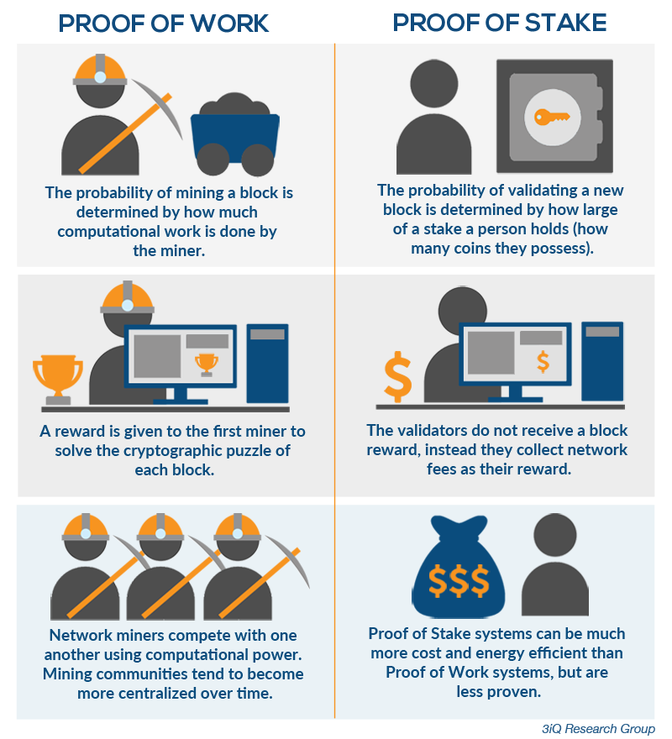
Proof of Work

Slide 36
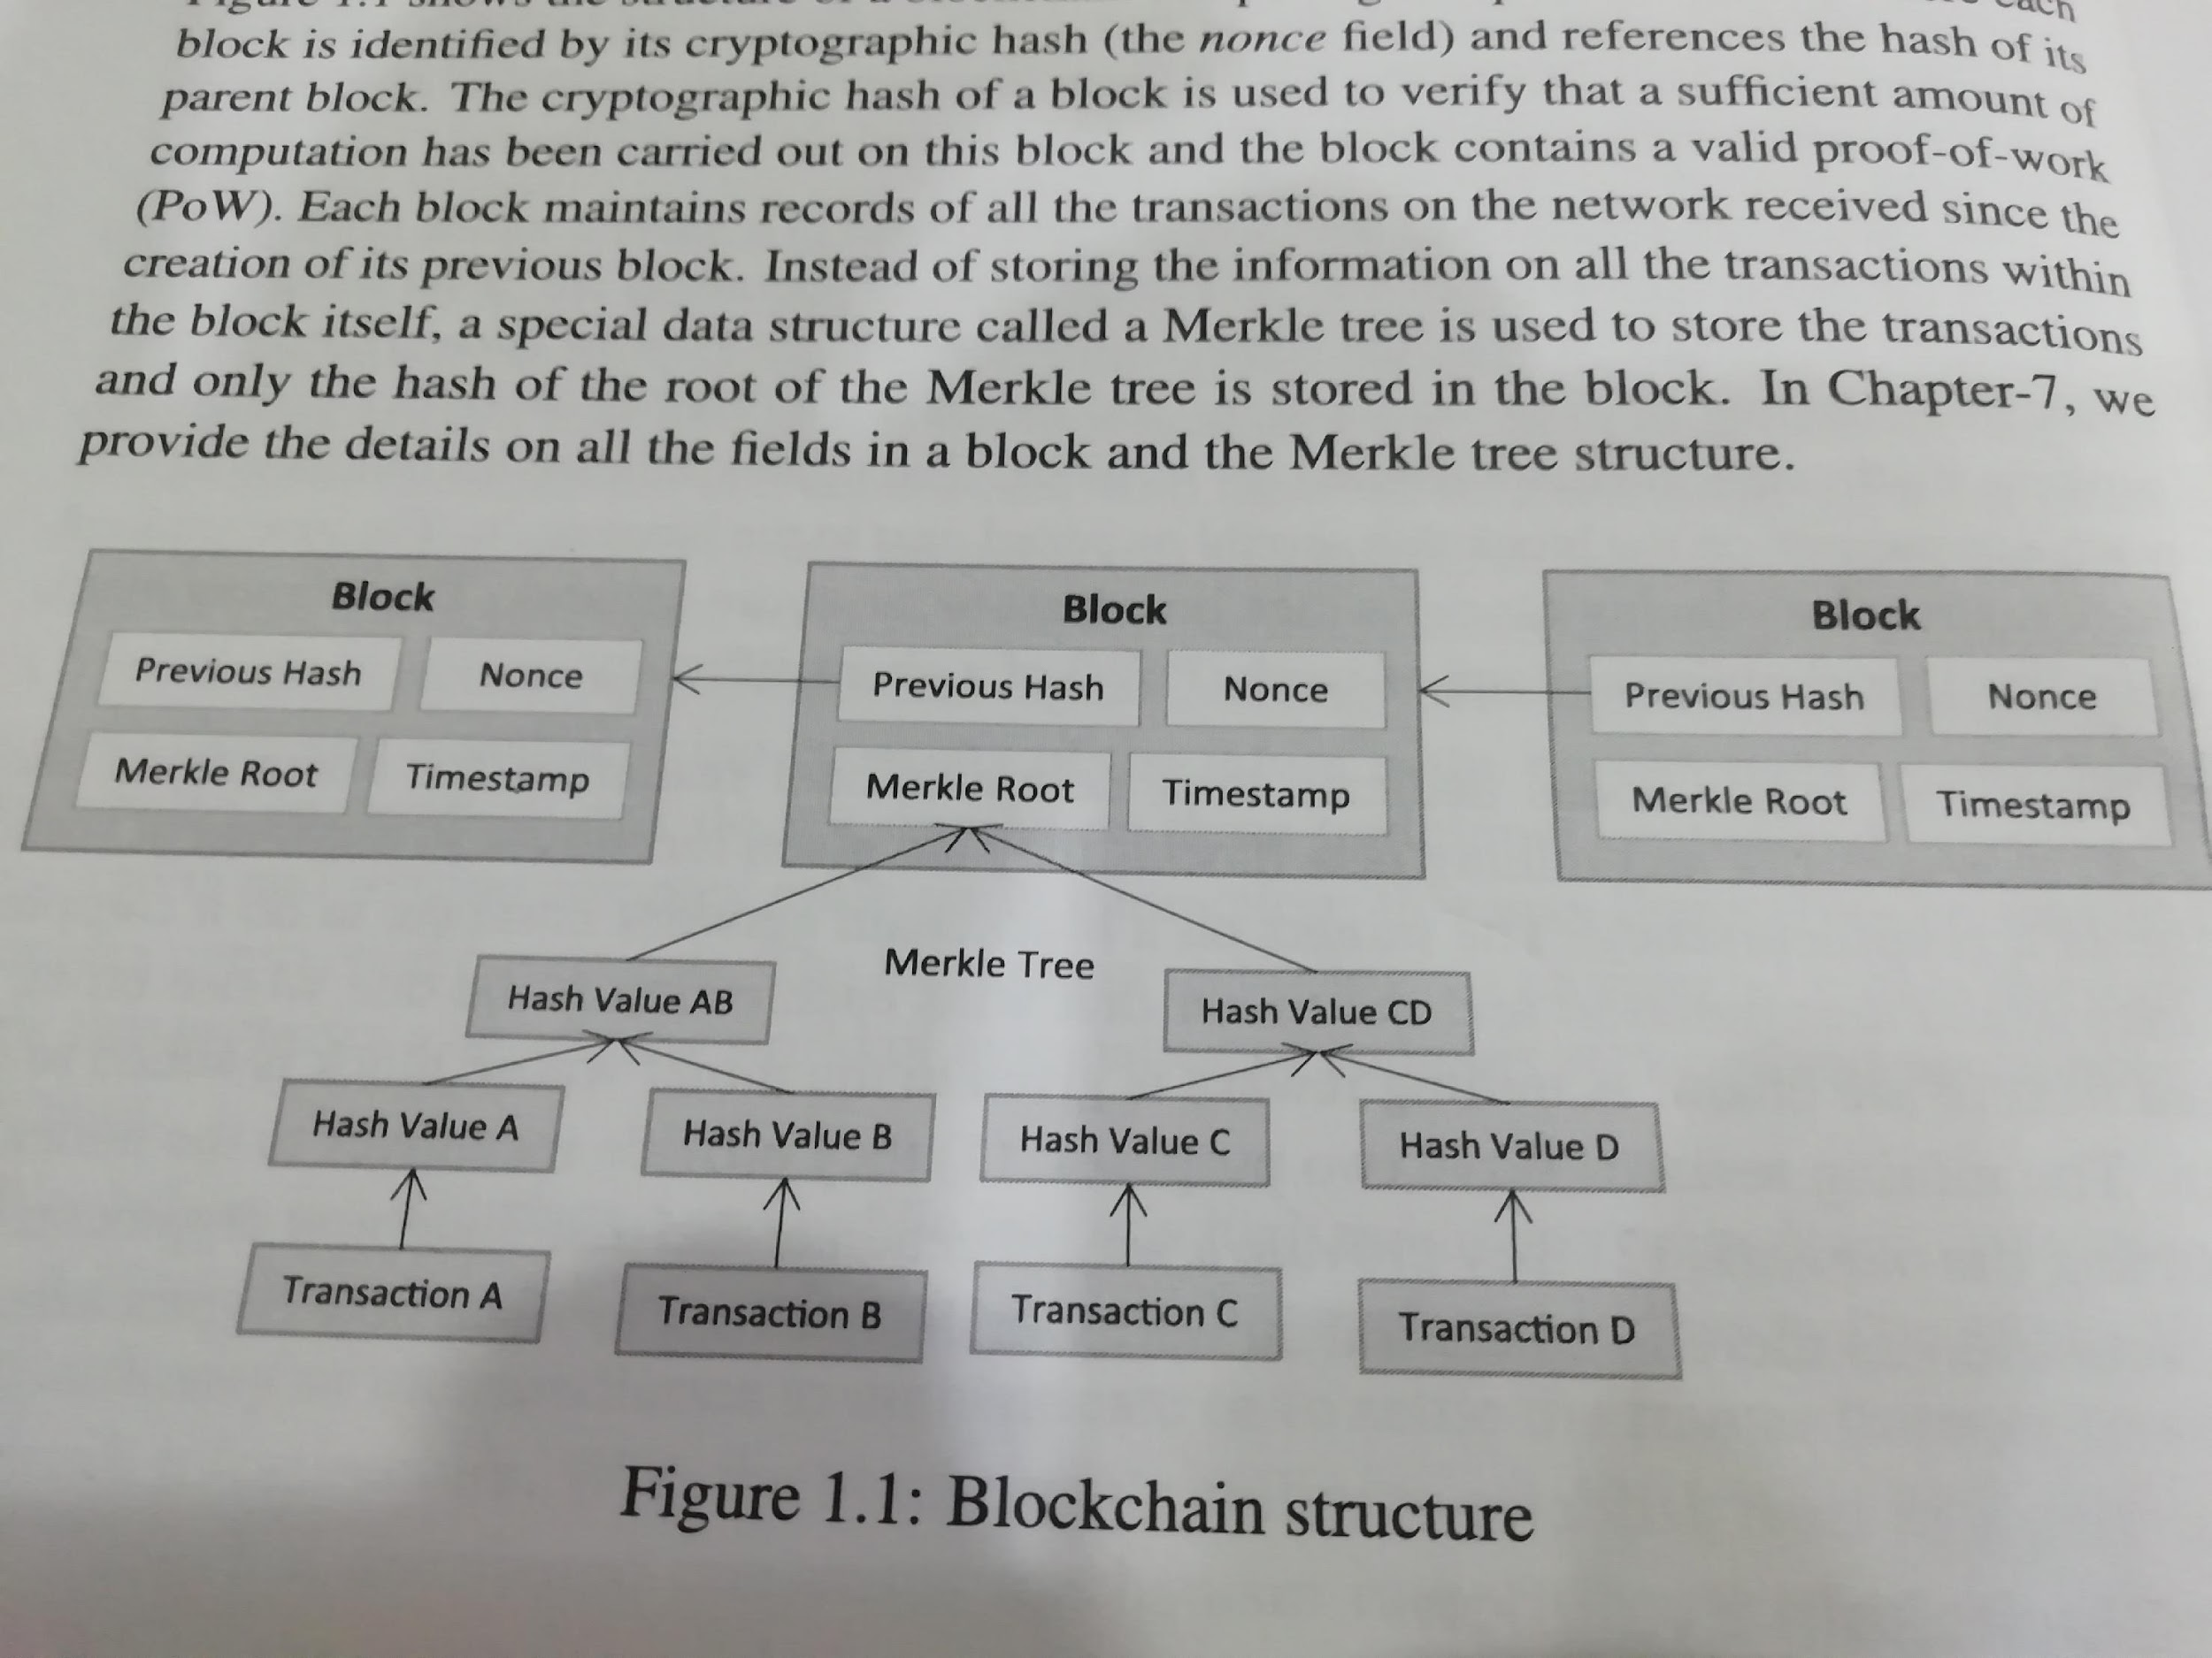
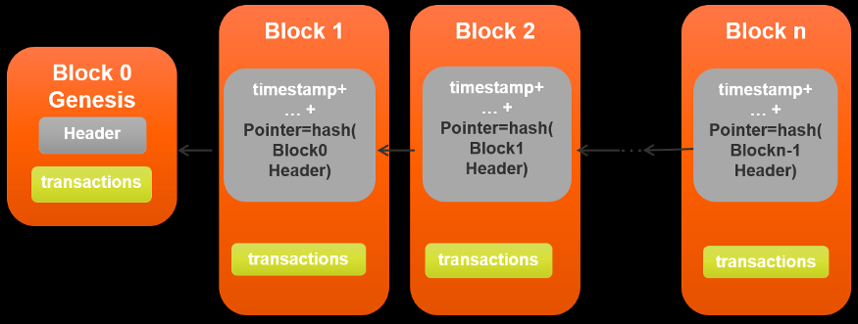
Blockchain Structure
https://www.freecodecamp.org/news/how-does-blockchain-really-work-i-built-an-app-to-show-you-6b70cd4caf7d/
A nounce (number only used once)is a number added to a Hash block that when rehashed , meet the difficulty level restrictions. It is 32 bit field.
This value will be adjusted by the miners.

Slide 37
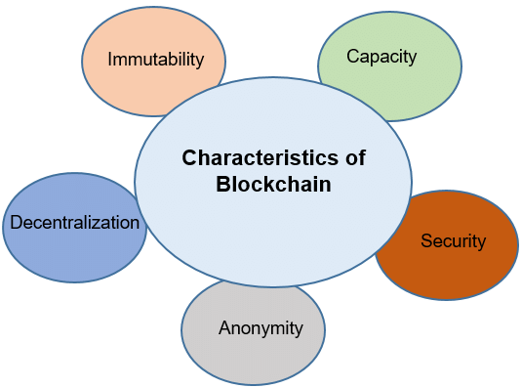
https://medium.com/coinmonks/understanding-and-creating-blockchains-86662c8e7516
https://www.codementor.io/learn/blockchain/development-tools

Slide 38
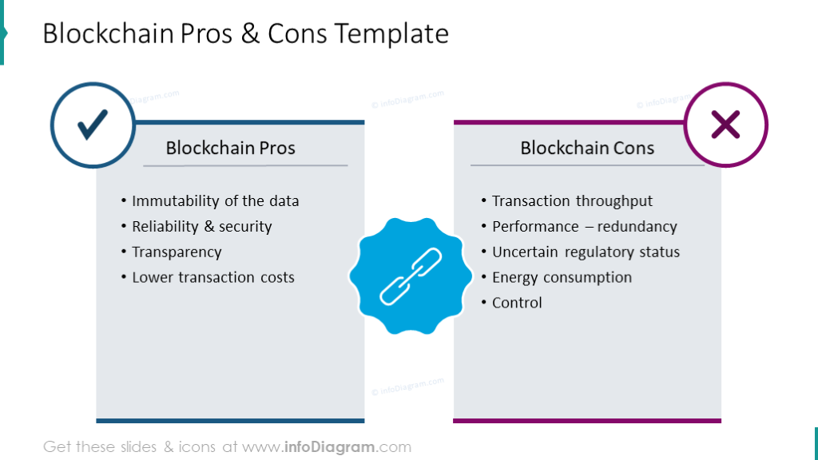
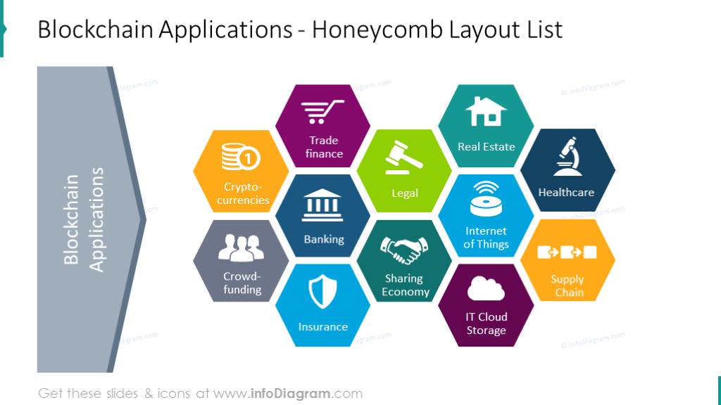

Slide 39
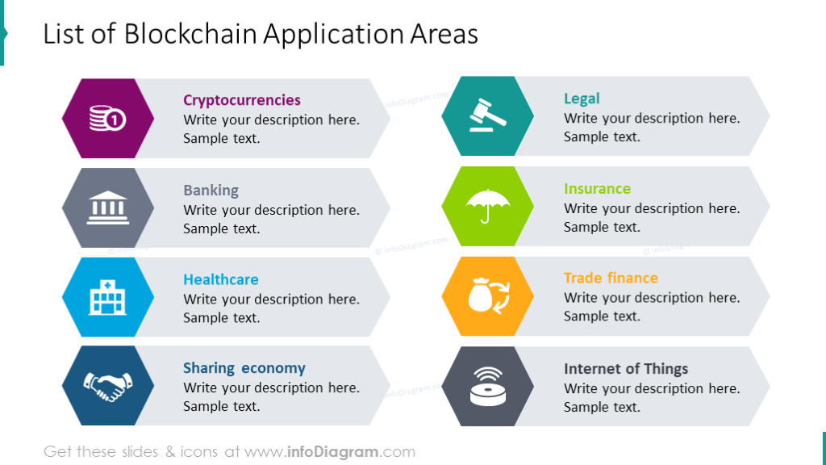

Slide 40
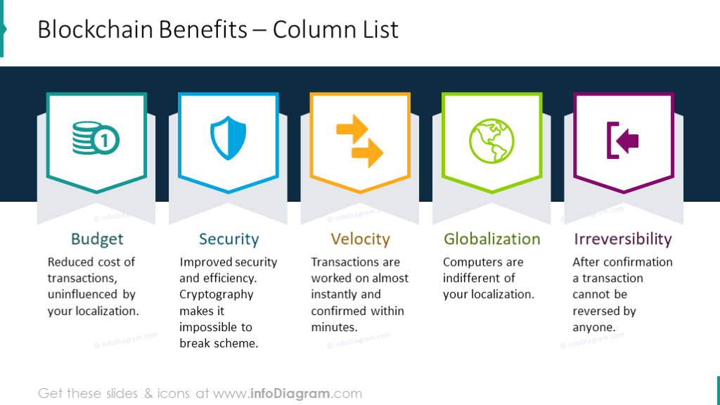

Slide 41
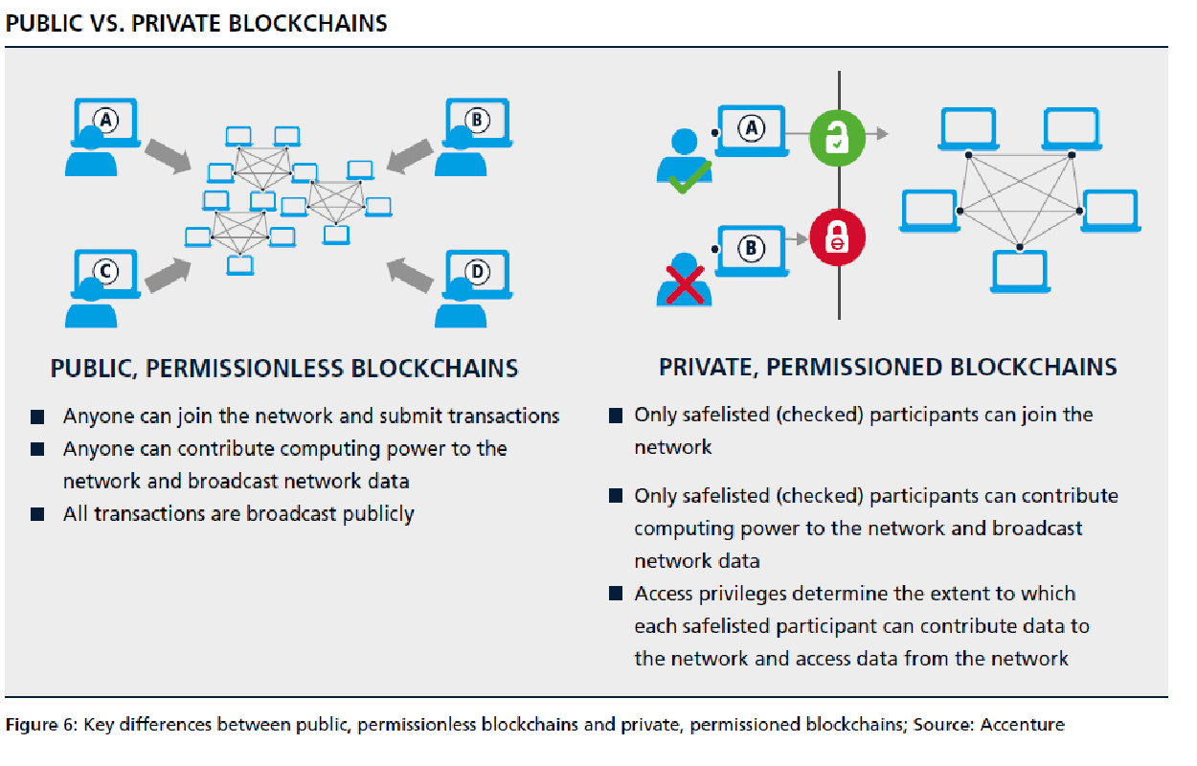

Slide 42
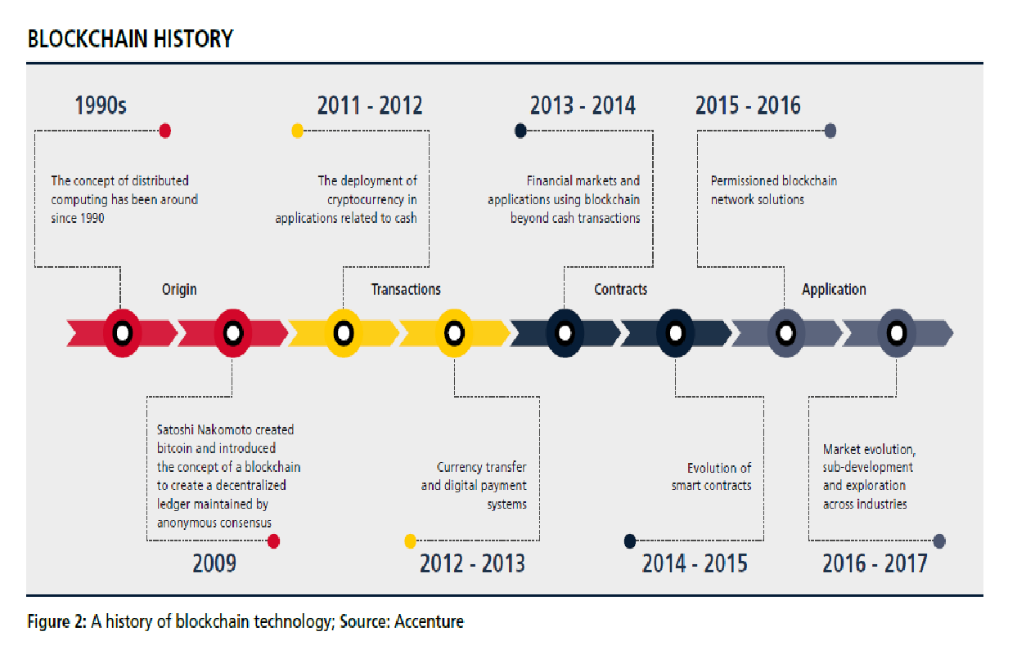

Slide 43
What is Bitcoin
A protocol that supports a decentralized, pseudo-anonymous, peer-to-peer digital currency*
A publicly disclosed linked ledger of transactions stored in a blockchain
A reward driven system for achieving consensus (mining) based on “Proofs of Work” for helping to secure the network
A “scare token” economy with an eventual cap of about 21M bitcoins
* I would argue it behaves more like a security like a Stock or Bond than a currency, a crypto-equity

Slide 44
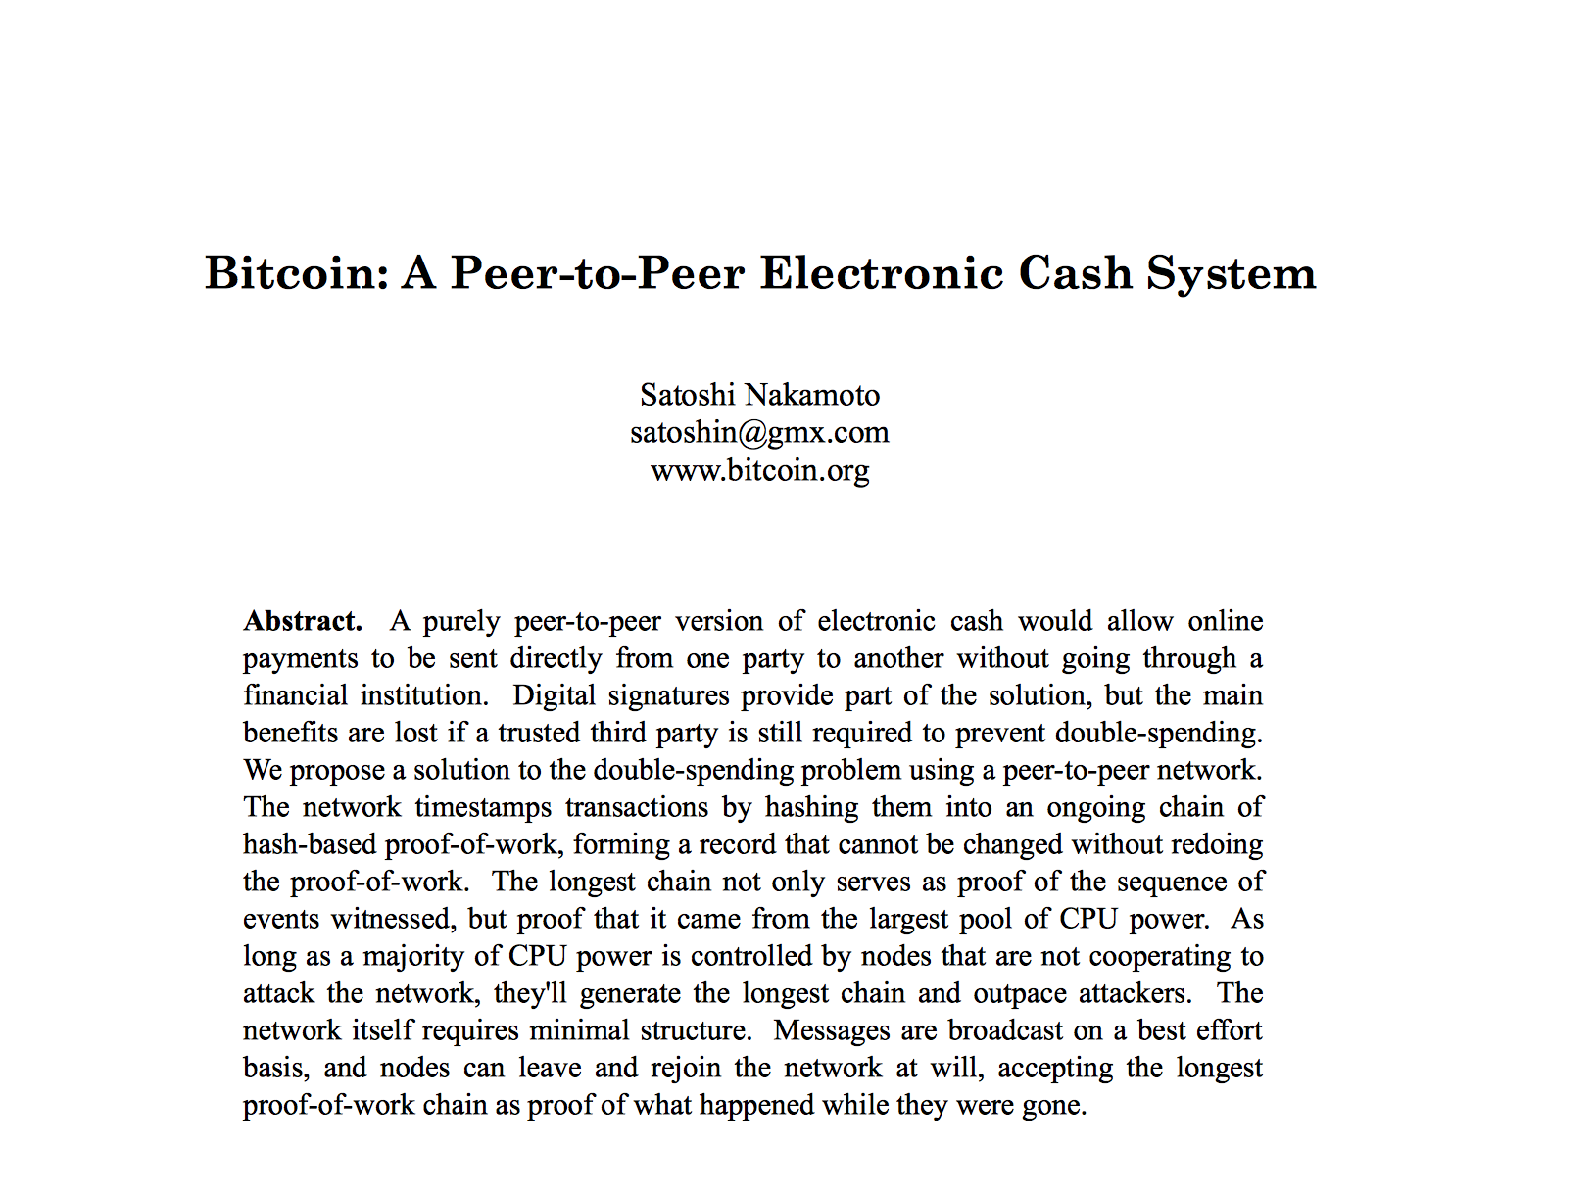
Bitcoin Whitepaper – 2008.10.31*

Slide 45
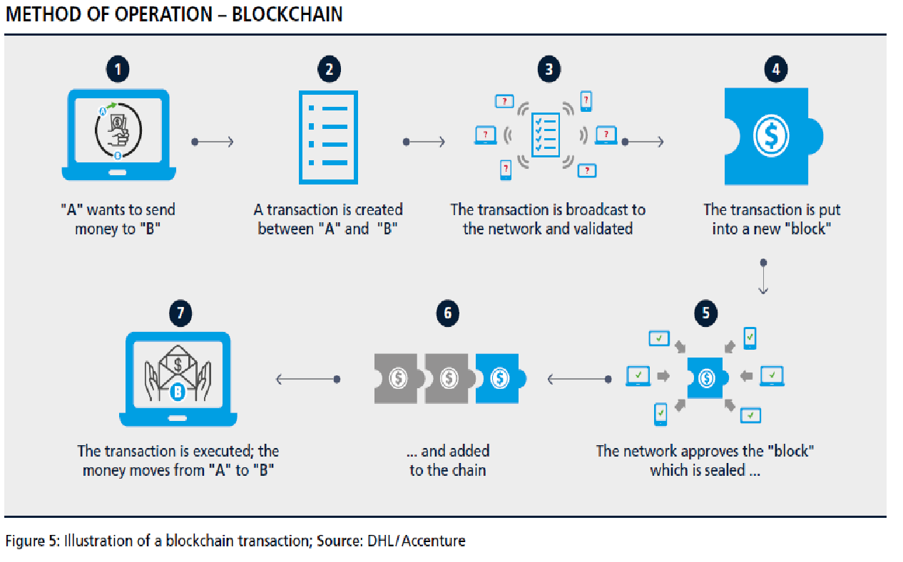

Slide 46
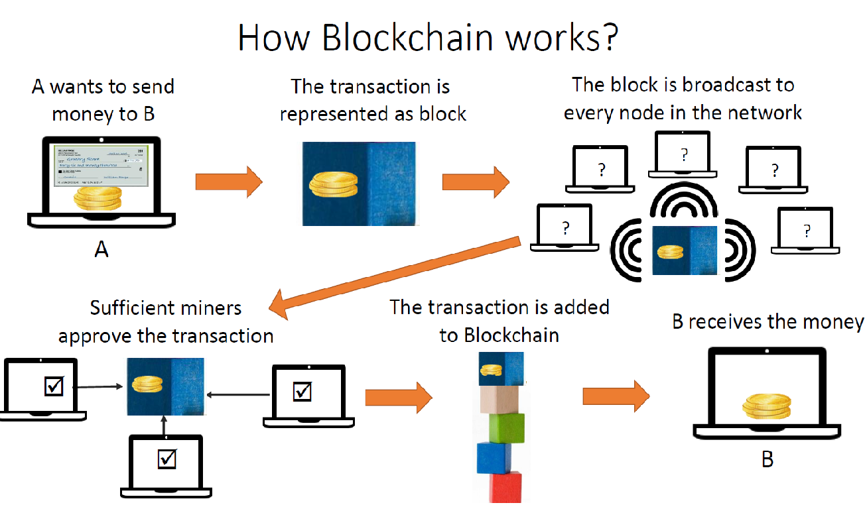
https://www.tutorialspoint.com/blockchain_online_training/blockchain_a_short_history.asp

Slide 47
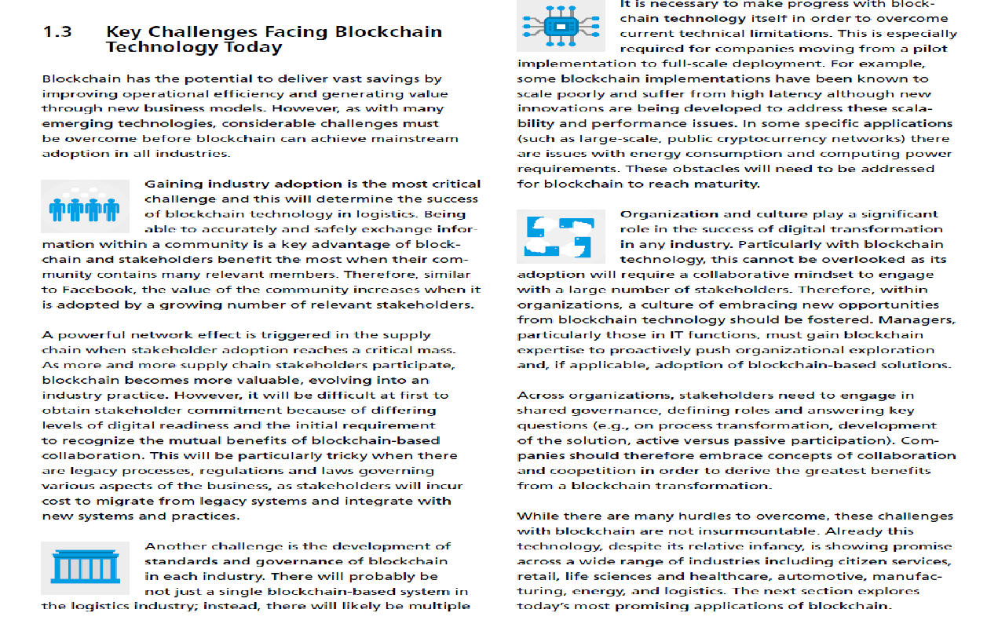

Slide 48
TECHNOLOGIES REQUIRED
1. Python
2. Node JS
3. JAVA
4. Java script
5. Solidity
6. Ethereum

Slide 49
ADDITIONAL RESOURCES
Bitcoin White Paper – Satoshi Nakamoto
Blockchain Demo – Anders Brownworth
Videos
Blockchain for Business - An Introduction to Hyperledger Technologies - edX.org
Ethereum White Paper
Guardtime – Blockchain like official site
Hyperledger official site - Linux Foundation
IBM Blockchain for Business – IBM Dev Center
IBM Blockchain Essentials Course – IBM Dev Center
IBM Blockchain Foundation Developer – IBM Dev Center
Many more and pages are always changing

